Slide 1
Digital Portfolio
STUDENT NAME:S.RAJA
REGISTER NO AND NMID: 24133121802521033&autanm31231225ucsc031
DEPARTMENT: B.SC computer science
COLLEGE: Government Arts and science college –Rishivadhiyan
1
Notes:
1

Slide 2
PROJECT TITLE . Creative trading portfolio using FWD
2
Creative student Portfolio Student Using FWD

Slide 3


AGENDA
Problem Statement
Project Overview
End Users
Tools and Technologies
Portfolio design and Layout
Features and Functionality
Results and Screenshots
Conclusion
Github Link
3/21/2024 Annual Review
3

Slide 4

PROBLEM STATEMENT . Not to use the system free . Payment high answer
4

Slide 5

PROJECT OVERVIEW . Portfolio contains, About me, project , Skills , Contacts
5

Slide 6

WHO ARE THE END USERS? 1. Students use it to learn and practice coding. 2. Developers use it to test and share projects. 3. Designers use it to create and showcase creative work.
6

Slide 7

TOOLS AND TECHNIQUES 1.Code Pen provides editors for HTML, CSS, and JavaScript. 2.It has live preview to see changes instantly. 3.Users can use libraries and frameworks easily. 4.It offers sharing, embedding, and collaboration tools.
7

Slide 8
POTFOLIO DESIGN AND LAYOUT
Portfolios on CodePen highlight coding skills visually.
Layouts are flexible and easy to customize.
CodePen offers creative portfolio designs and layouts. Users can showcase their projects in stylish ways.
8

Slide 9
FEATURES AND FUNCTIONALITY 1.Code Pen lets you write and run HTML, CSS, and JavaScript online. 2. It shows live preview of your code instantly. 3. You can share, learn, and explore projects made by others.

Slide 10
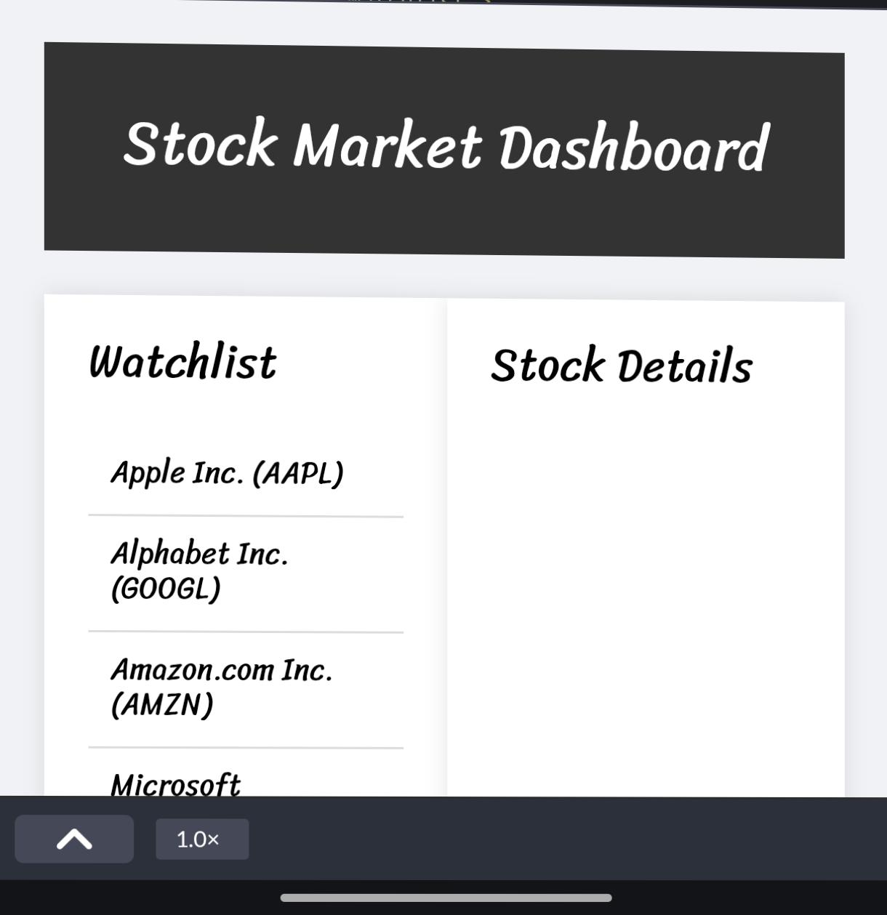

RESULTS AND SCREENSHOTS
3/21/2024 Annual Review
10

Slide 11
CONCLUSION 1.Code Pen is an online place to write code. 2. It helps test ideas quickly. 3. You can share work with others. 4.It is useful for learning and practice Code Pen makes coding easy and fun. .
11
Notes:
Jhjjj
11

